Slide 1
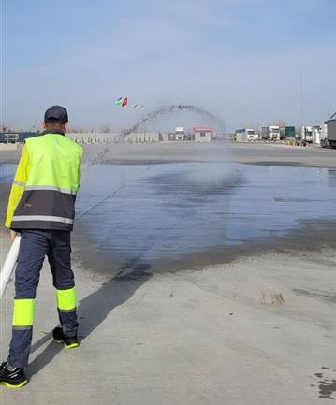
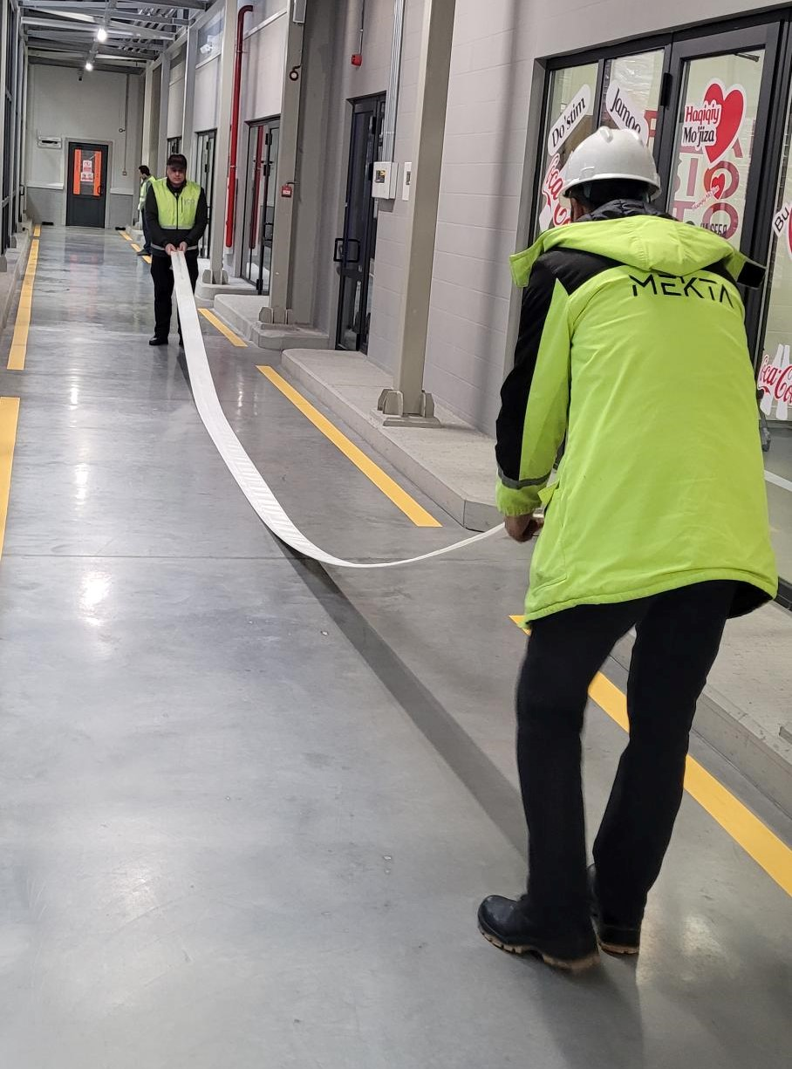
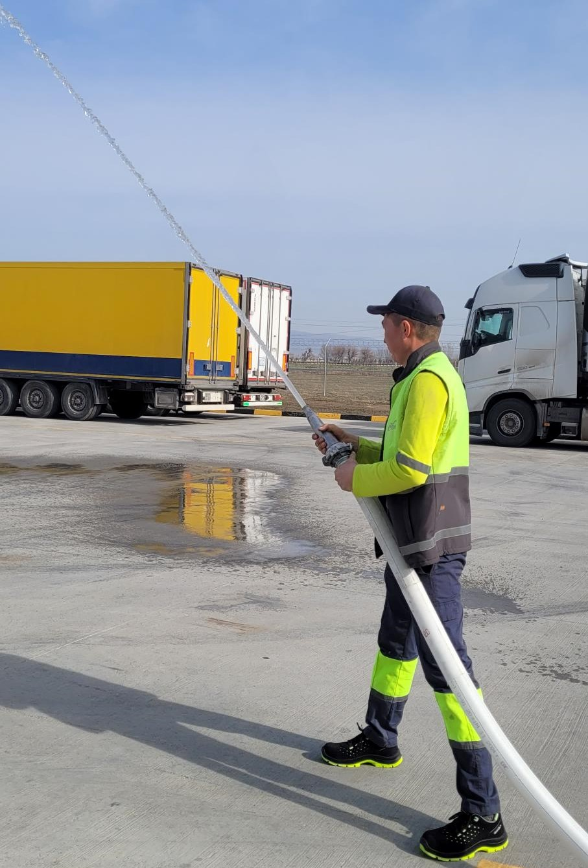
Fire hydrant inspection
Samarkand, 04 February 2026
Participants:
H&S Engineer
Security Supervisor
ORA Insaat, Mekta representatives
Utilities team
In total, 78 fire hydrants were inspected

Slide 2
Findings | Fire Hydrant № | Location | Evidence
The fire hose nozzle is attached to the fire hose with a clamp, which is an unreliable connection. During testing, a leak was detected; the connection must be replaced immediately. | ПК 28-2 | Along the corridor towards the chemical storage.
Wear on the fire hose was identified. A leak was detected during testing. | The fire hydrant is not numbered | CO2 plant
The fire hose nozzle is missing. It is necessary to install the nozzle. | The fire hydrant is not numbered | CO2 plant
The fire hose is missing. It is necessary to install the fire hose. | ПК 30-2 | Boiler room
The fire hydrant cabinet door is damaged and has a dent. It is necessary to repair or replace the door. | ПК 43-2 | RGB Line/Warehouse
Findings | Fire Hydrant № | Location | Evidence
The storage of finished products has obstructed access to the fire hydrant. It is necessary to ensure free access to the fire hydrant and remove the finished products. | ПК 17-1 ПК 17-2 | NHFL Line/Warehouse
The glass of the fire hydrant cabinet is broken. It is necessary to install new glass. | ПК 15-2 | PET Line/Warehouse
The fire hose extension mechanism is missing. It is necessary to install the mechanism. | ПК 25-1 | Sugar warehouse
bolted connections of the extension mechanism on most fire hydrants are in unsatisfactory condition and do not ensure the required level of reliability. It is necessary to retighten the bolted connections and adjust the position of the mechanism. | N/A | All territory
Six fire hydrants were found without numbering; the marking may have been worn off. | The fire hydrants are not numbered | NHFL Line/Warehouse - 2 units Syrup room - 2 units CO2 plant - 2 units
Fire hoses with improper coiling were identified, which could have led to difficulties during uncoiling and use. During the inspection, the hoses were coiled correctly, and the nonconformities were rectified on site. | N/A | All territory

